Slide 1
Movie Notes Study
Alyssa Love

Slide 2
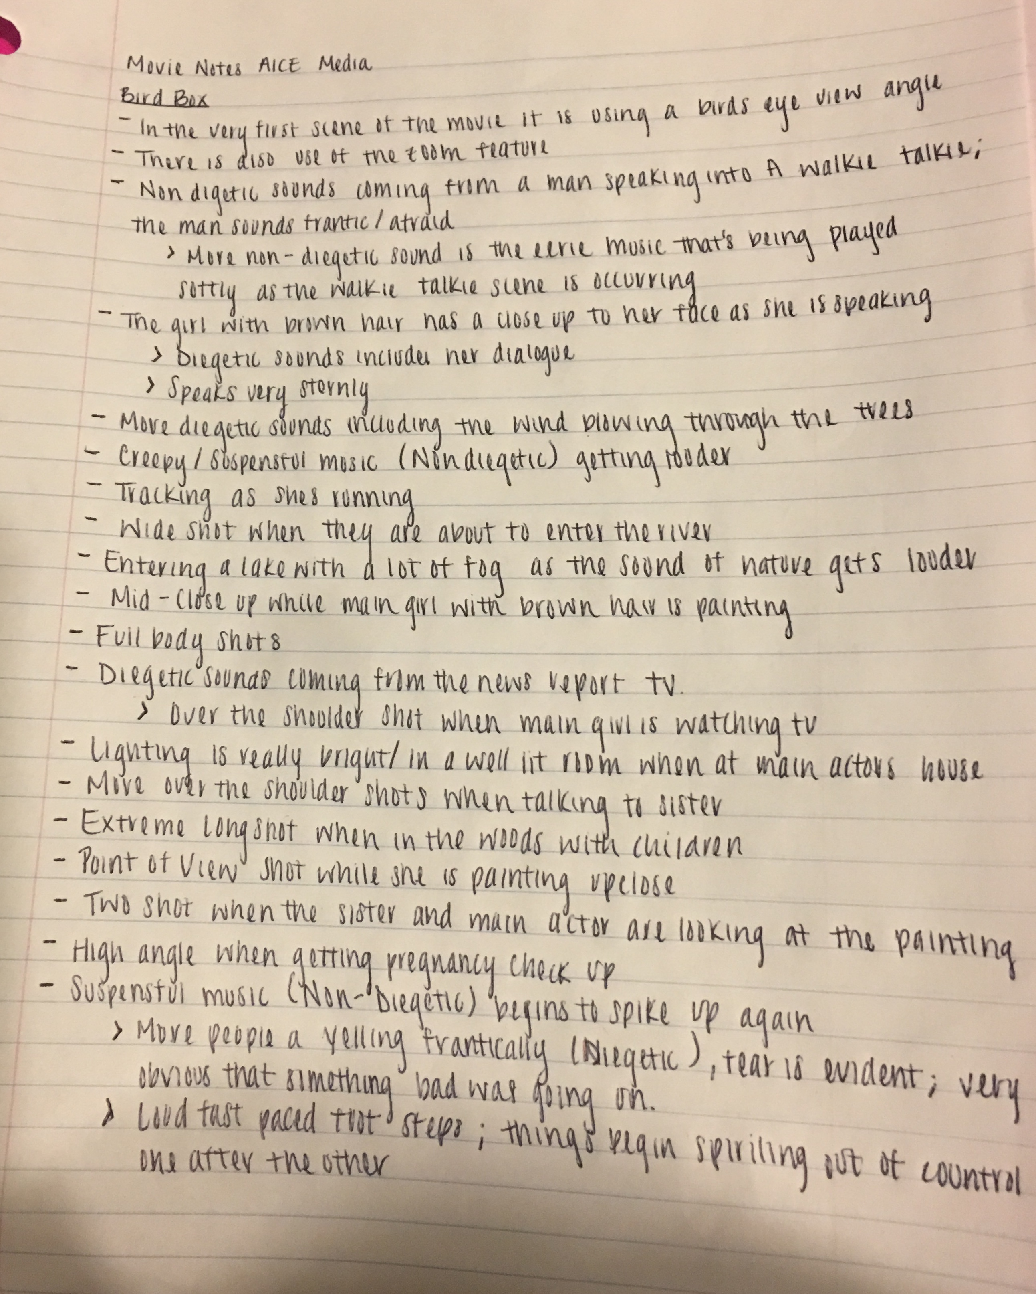
Bird Box

Slide 3
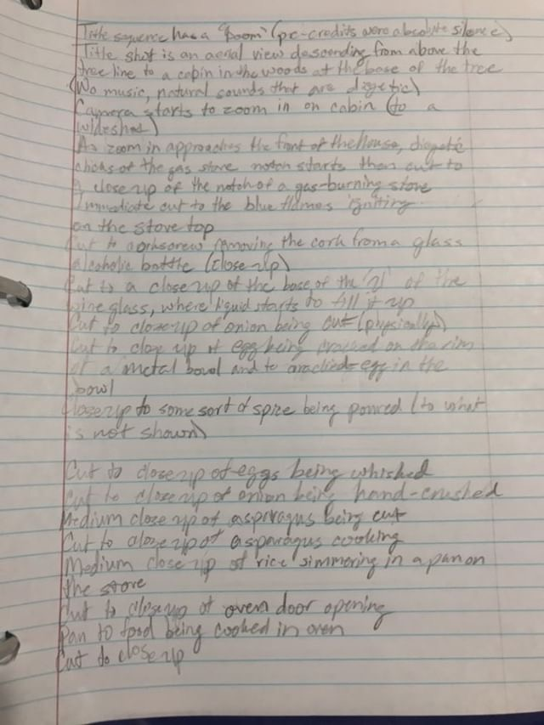
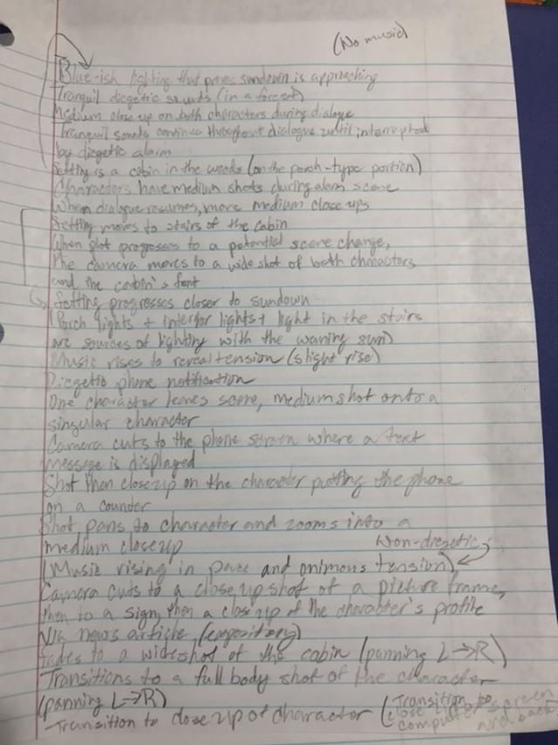
Hush

Slide 4
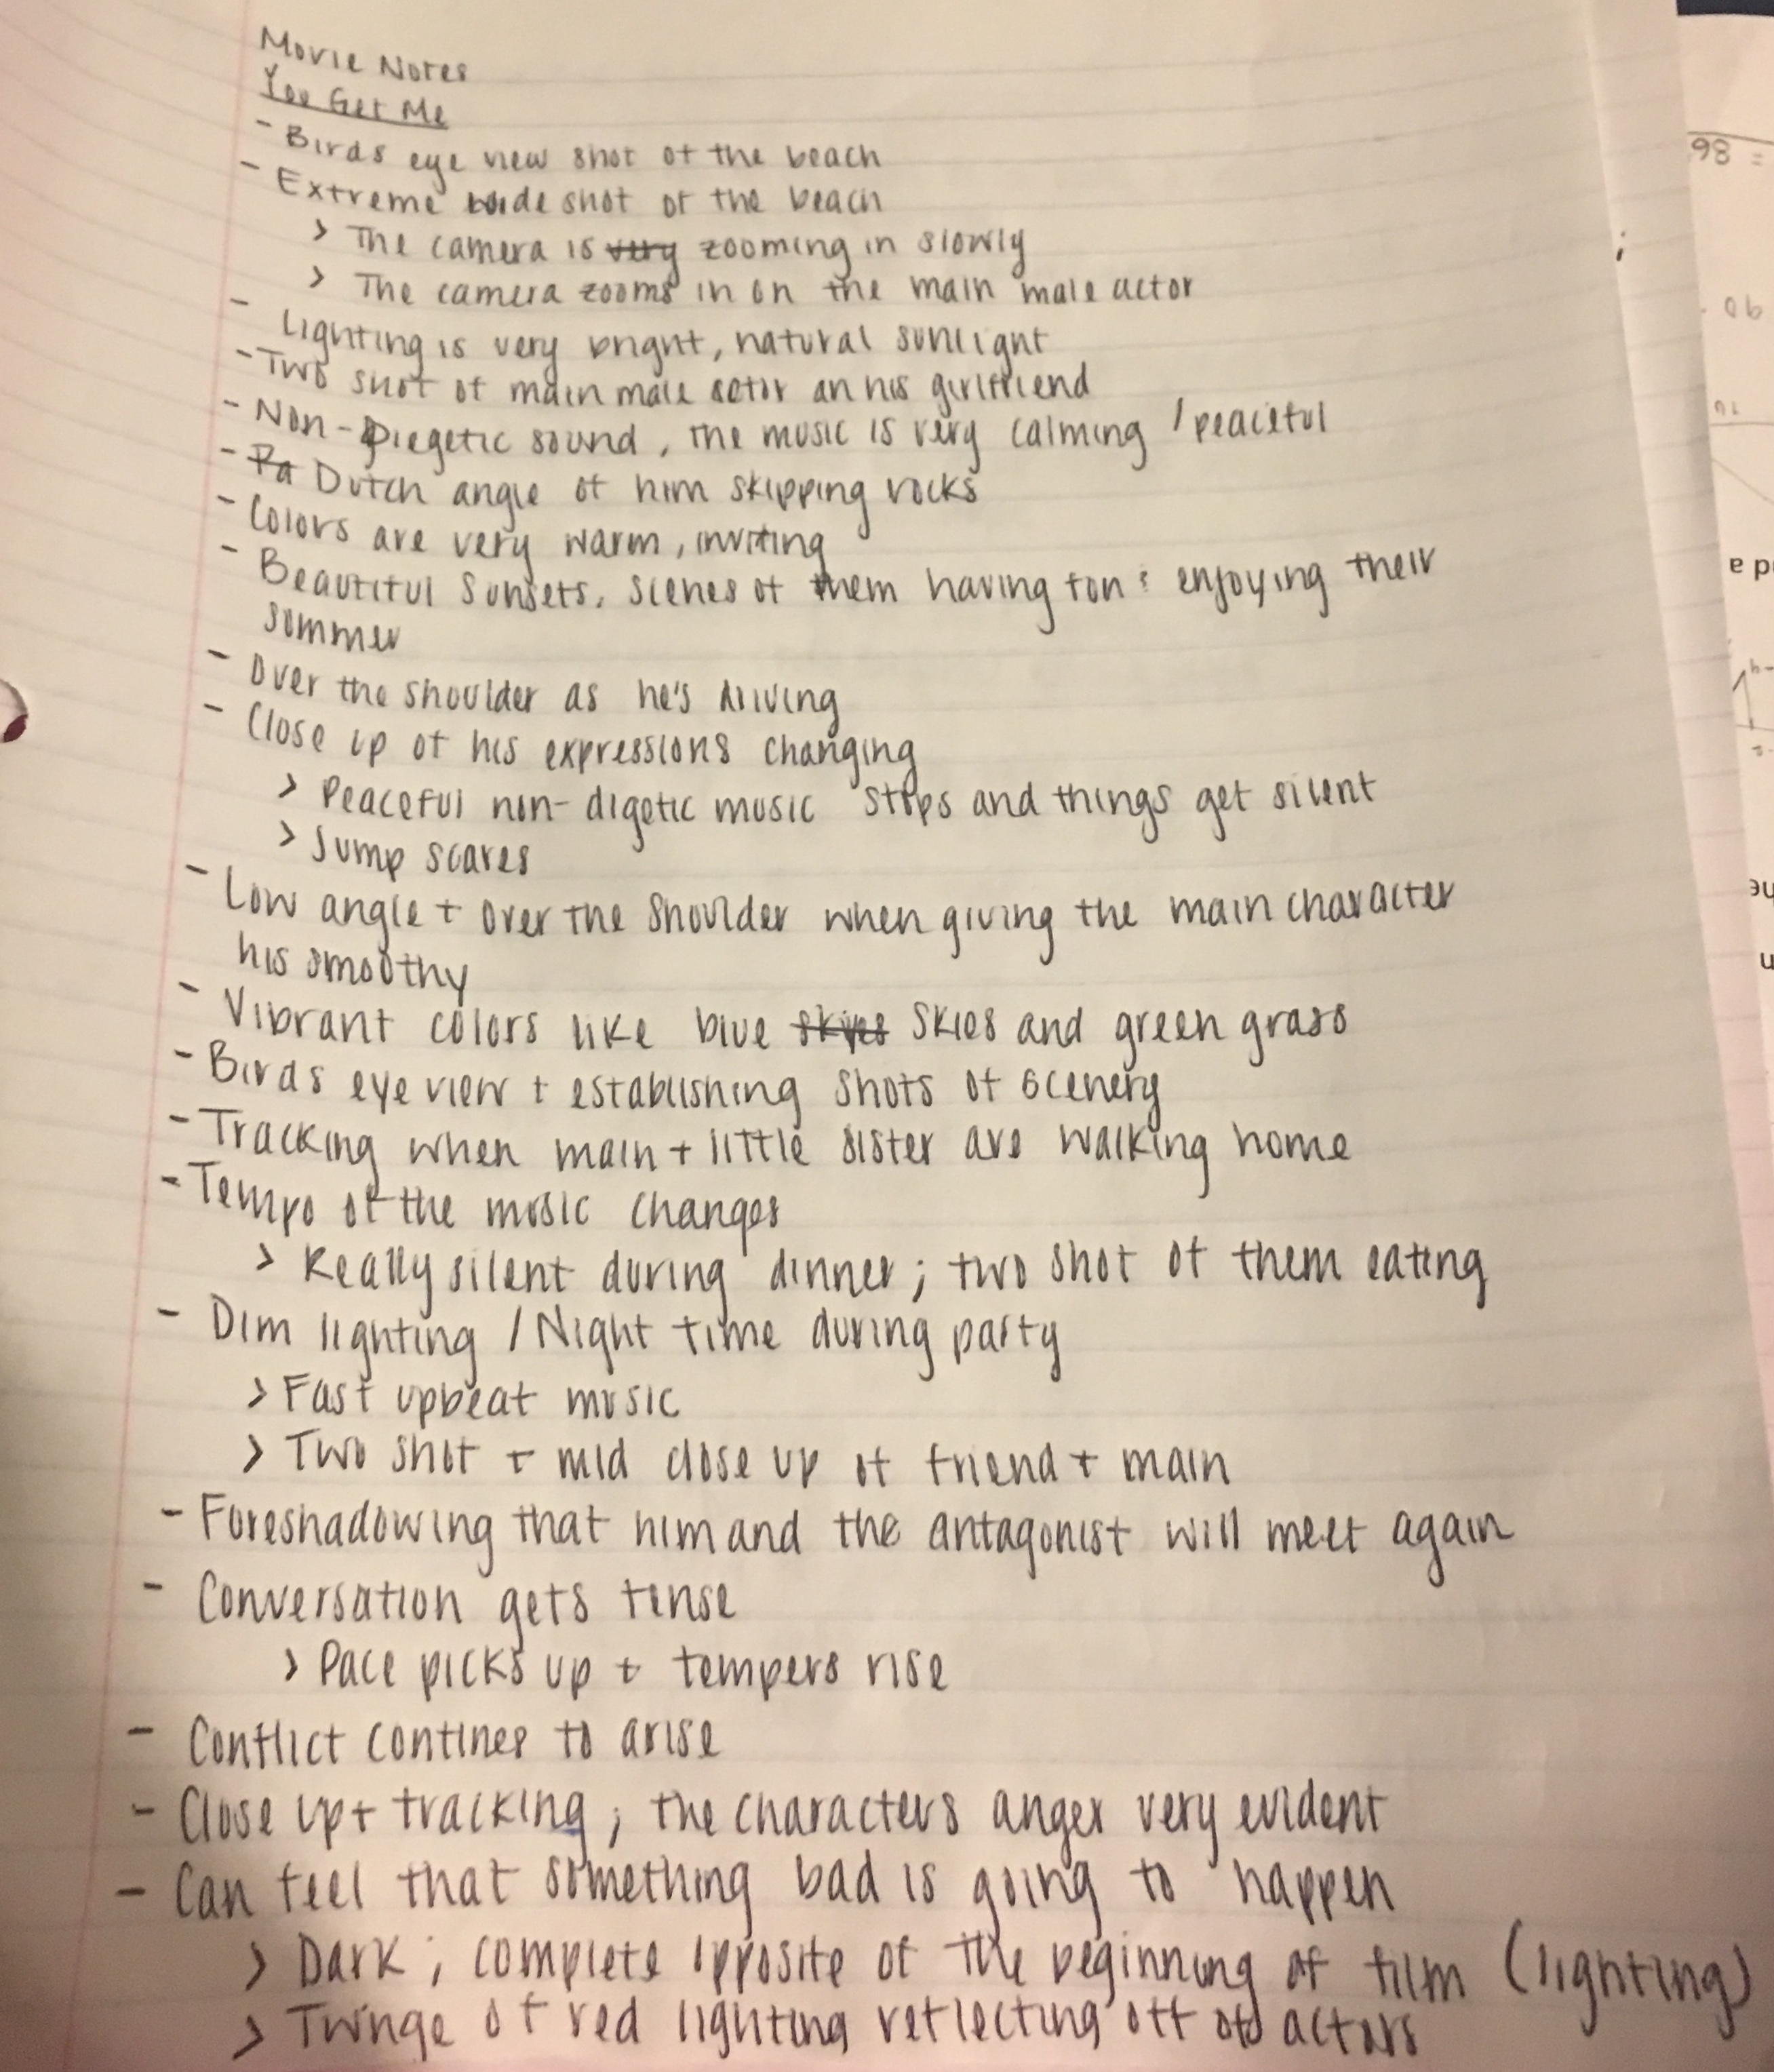
You Get Me

Slide 5
Film Openings Conclusions
All three of the thriller/suspense movies that I studied all seemed to have begun with shots like bird's eye view to capture the location. During this kind of shot they all gradually zoomed in and focused on a general area.
The films also paid special attention to little details and had a lot of close shots of things surrounded by the main actor/actress.
The lighting for the films were all very bright and vibrant. In You Get Me, the beginning of the movie was outside at a beach and had many warm, inviting tones. As for Bird box, the first half of the opening, which was a foreshadowing, was outdoors and had a lot of natural lighting but there were also grey skies whereas in You Get Me the skies were bright blue and the weather was perfect. Later in bird box it shows the actress in her studio which has large windows that also let a lot of natural sunlight in.
In Hush there were more diegetic sounds in that opening which differed from the other two films since they began playing Non-Diegetic sounds like music almost immediately. The music in bird box was more on the creepy/eerie side where you felt nervous as to what was going to happen next. The music made it really tense and nerve-wracking.

Slide 6
Film Openings Conclusions
As for the Non diegetic sounds in You Get Me, they weren't as edging as the non-diegetic sounds in Bird Box. The music in You Get Me was very peaceful and relaxing in the beginning as the actor was recapping his summer time fun. The music tempo did match the emotions of the actor though. If the actor was getting upset either the music would stop or it would speed up, making it seem as if the scene was picking up its pace. The music in the movie Hush picked up the pace in tempo whenever conflict was ear as well
All three films also all show the main actors/actresses in harmony and peace in their lives before everything gets out of hand
In Bird Box the diegetic sounds were coming from the television news cast that was foreshadowing the disease that was going to ruin her life altogether which was when the tension arose in that scene.
To conclude, You Get Me is a much slower paced movie where It has to build up in order to know that eventually something bad is going to happen whereas both Bird Box and Hush are quick t show that things begin to go bad very quickly. You Get Me and Hush also makes it obvious which characters are going to be key figures throughout the entirety of the movie. Bird Box doesn’t specify until much later which characters are going to be prominent factors, excluding the main character

