Slide 1
Planning PPT #3
Storyboard pages 1-6

Slide 2
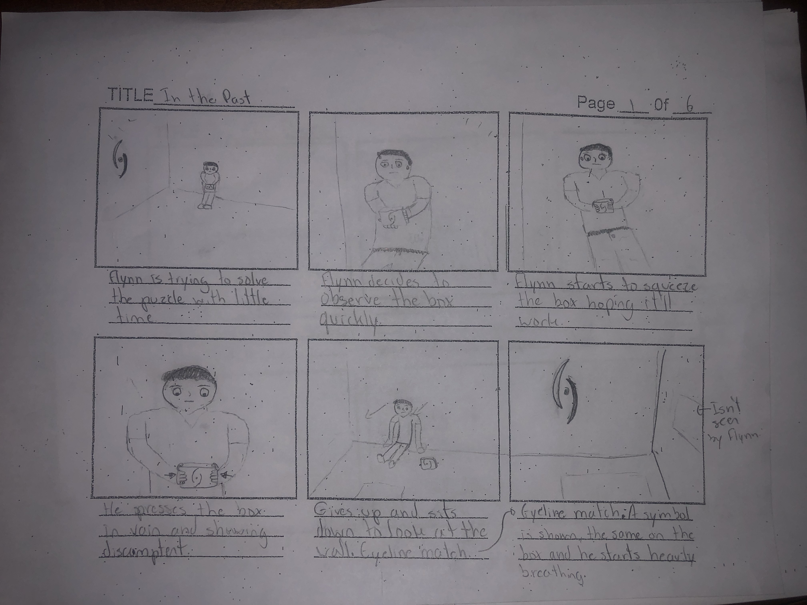
Page 1

Slide 3
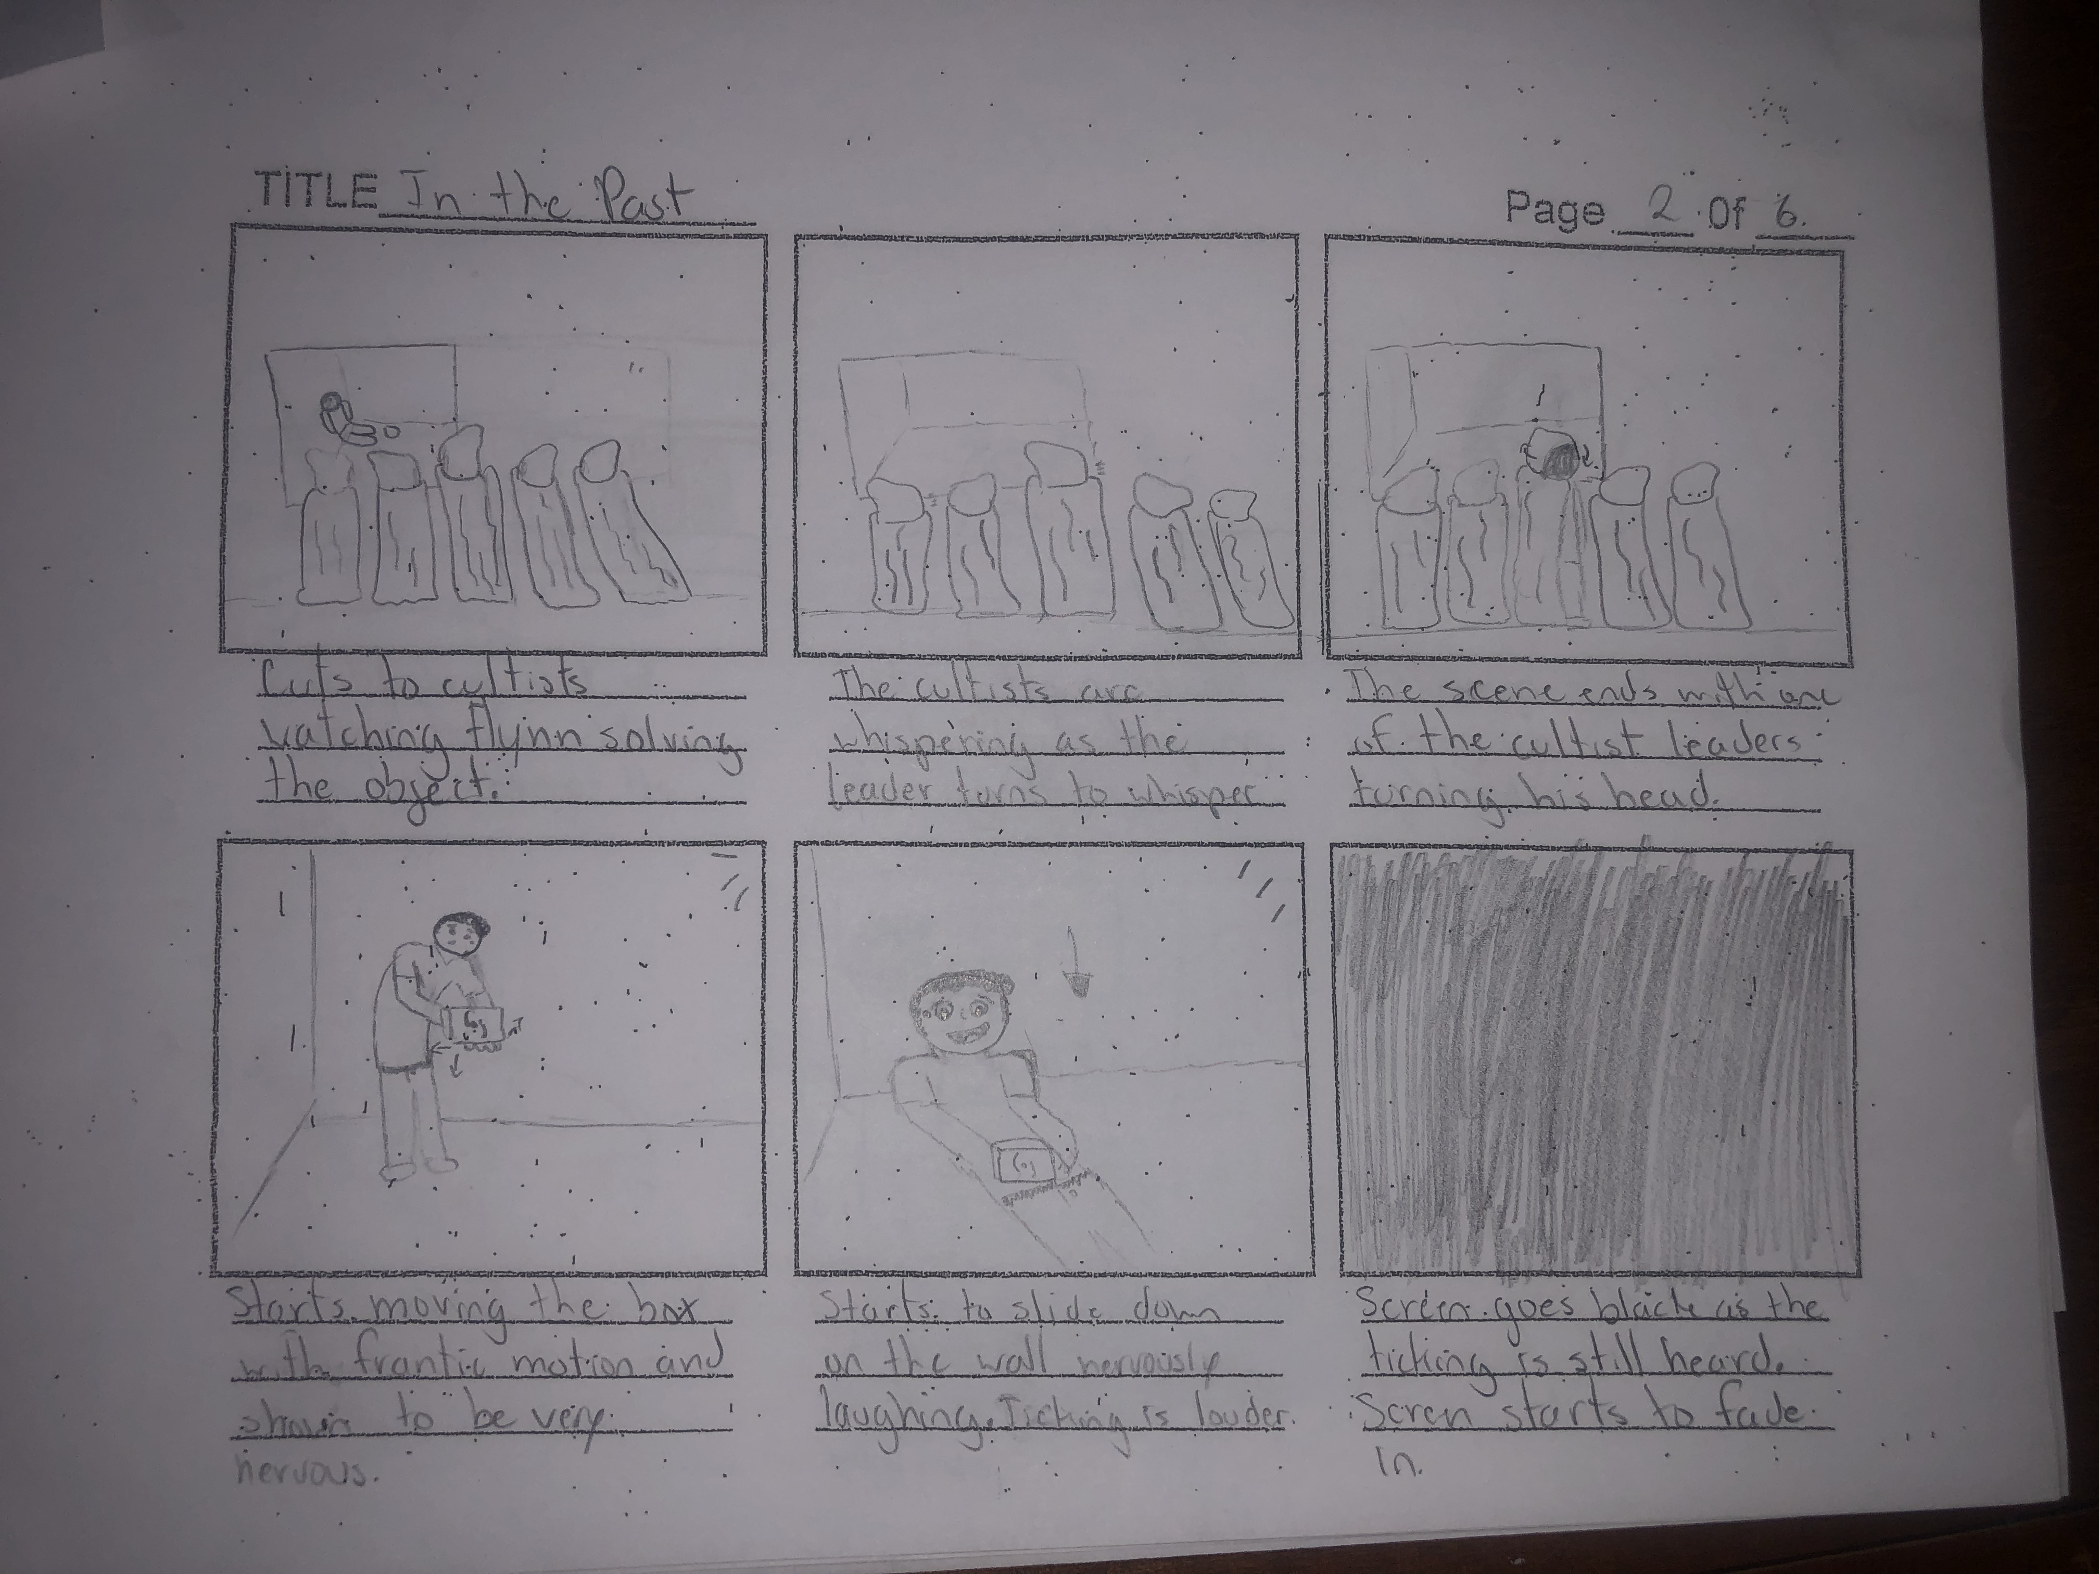
Page 2

Slide 4
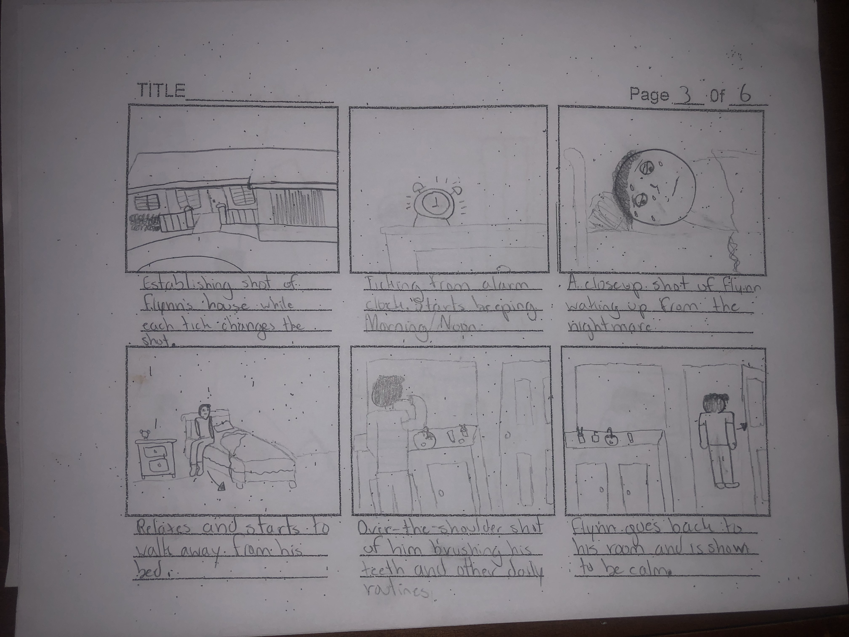
Page 3

Slide 5
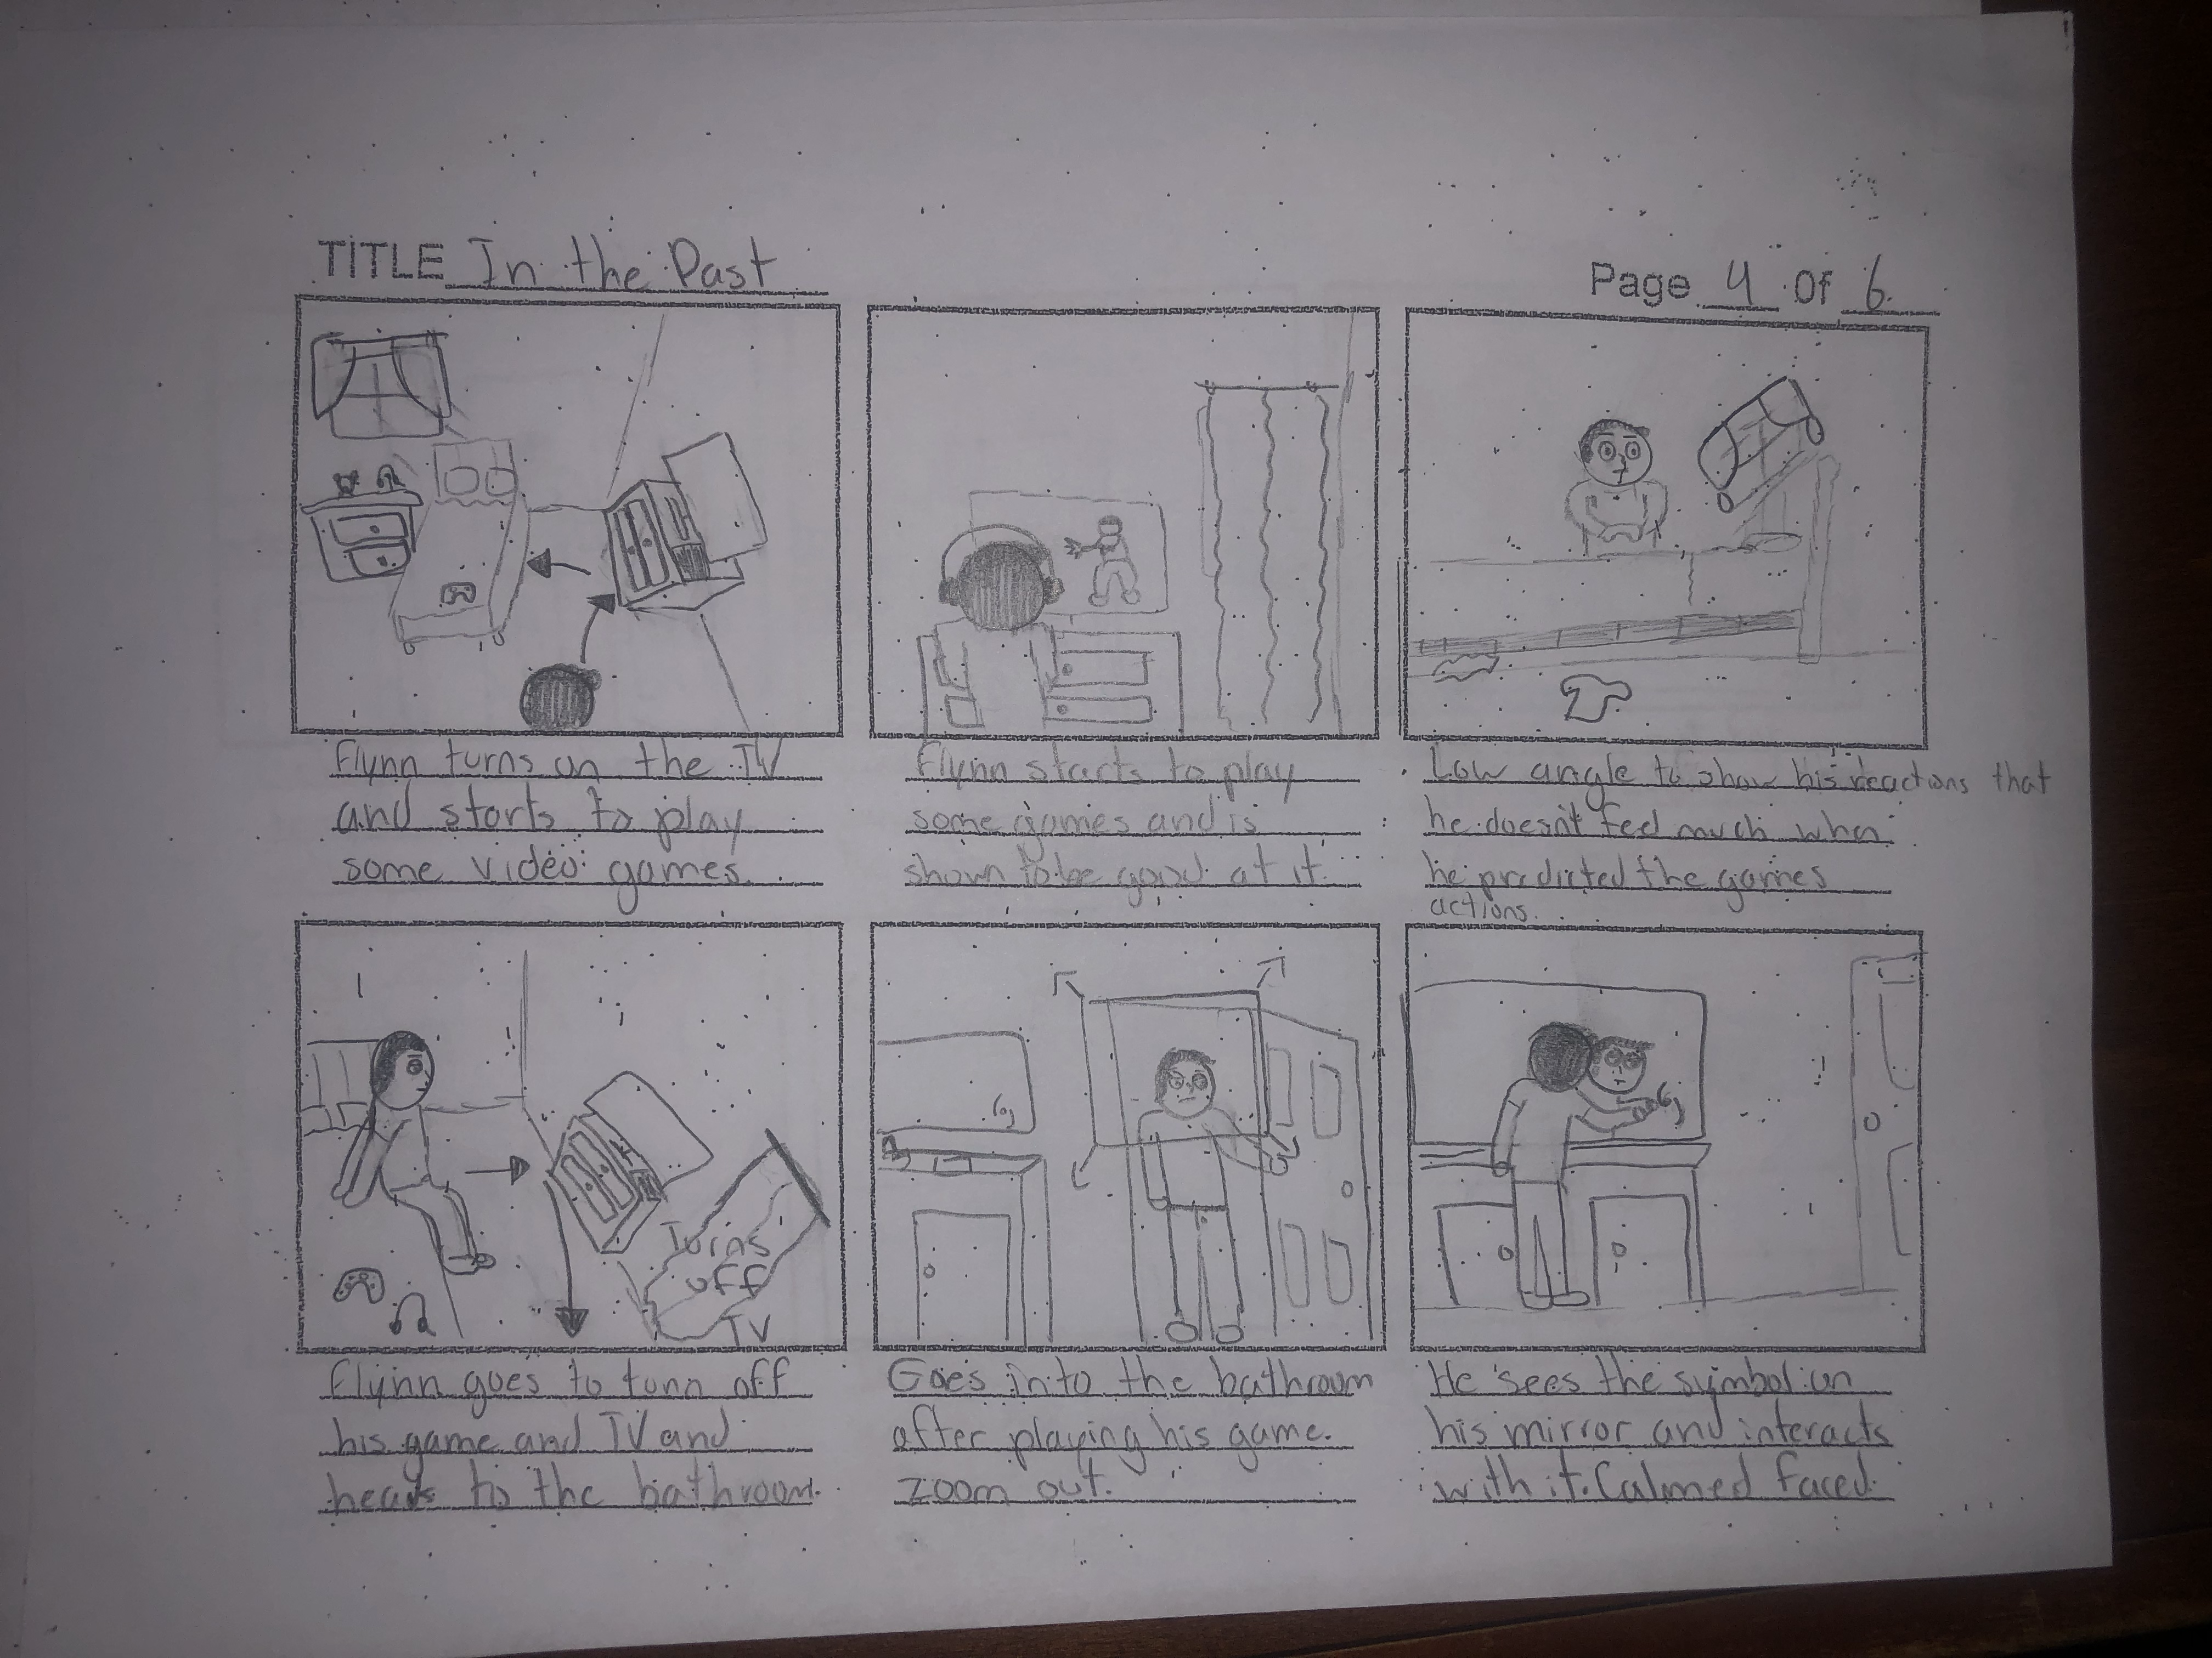
Page 4

Slide 6
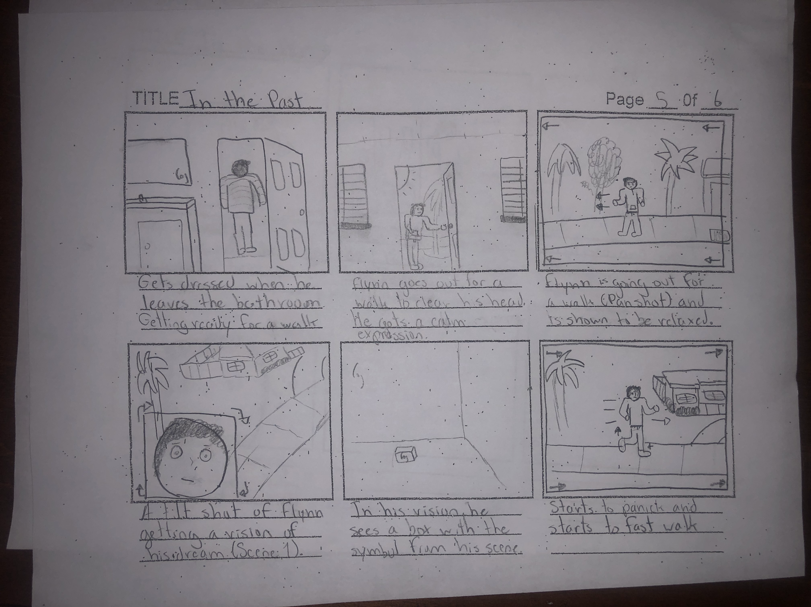
Page 5

Slide 7
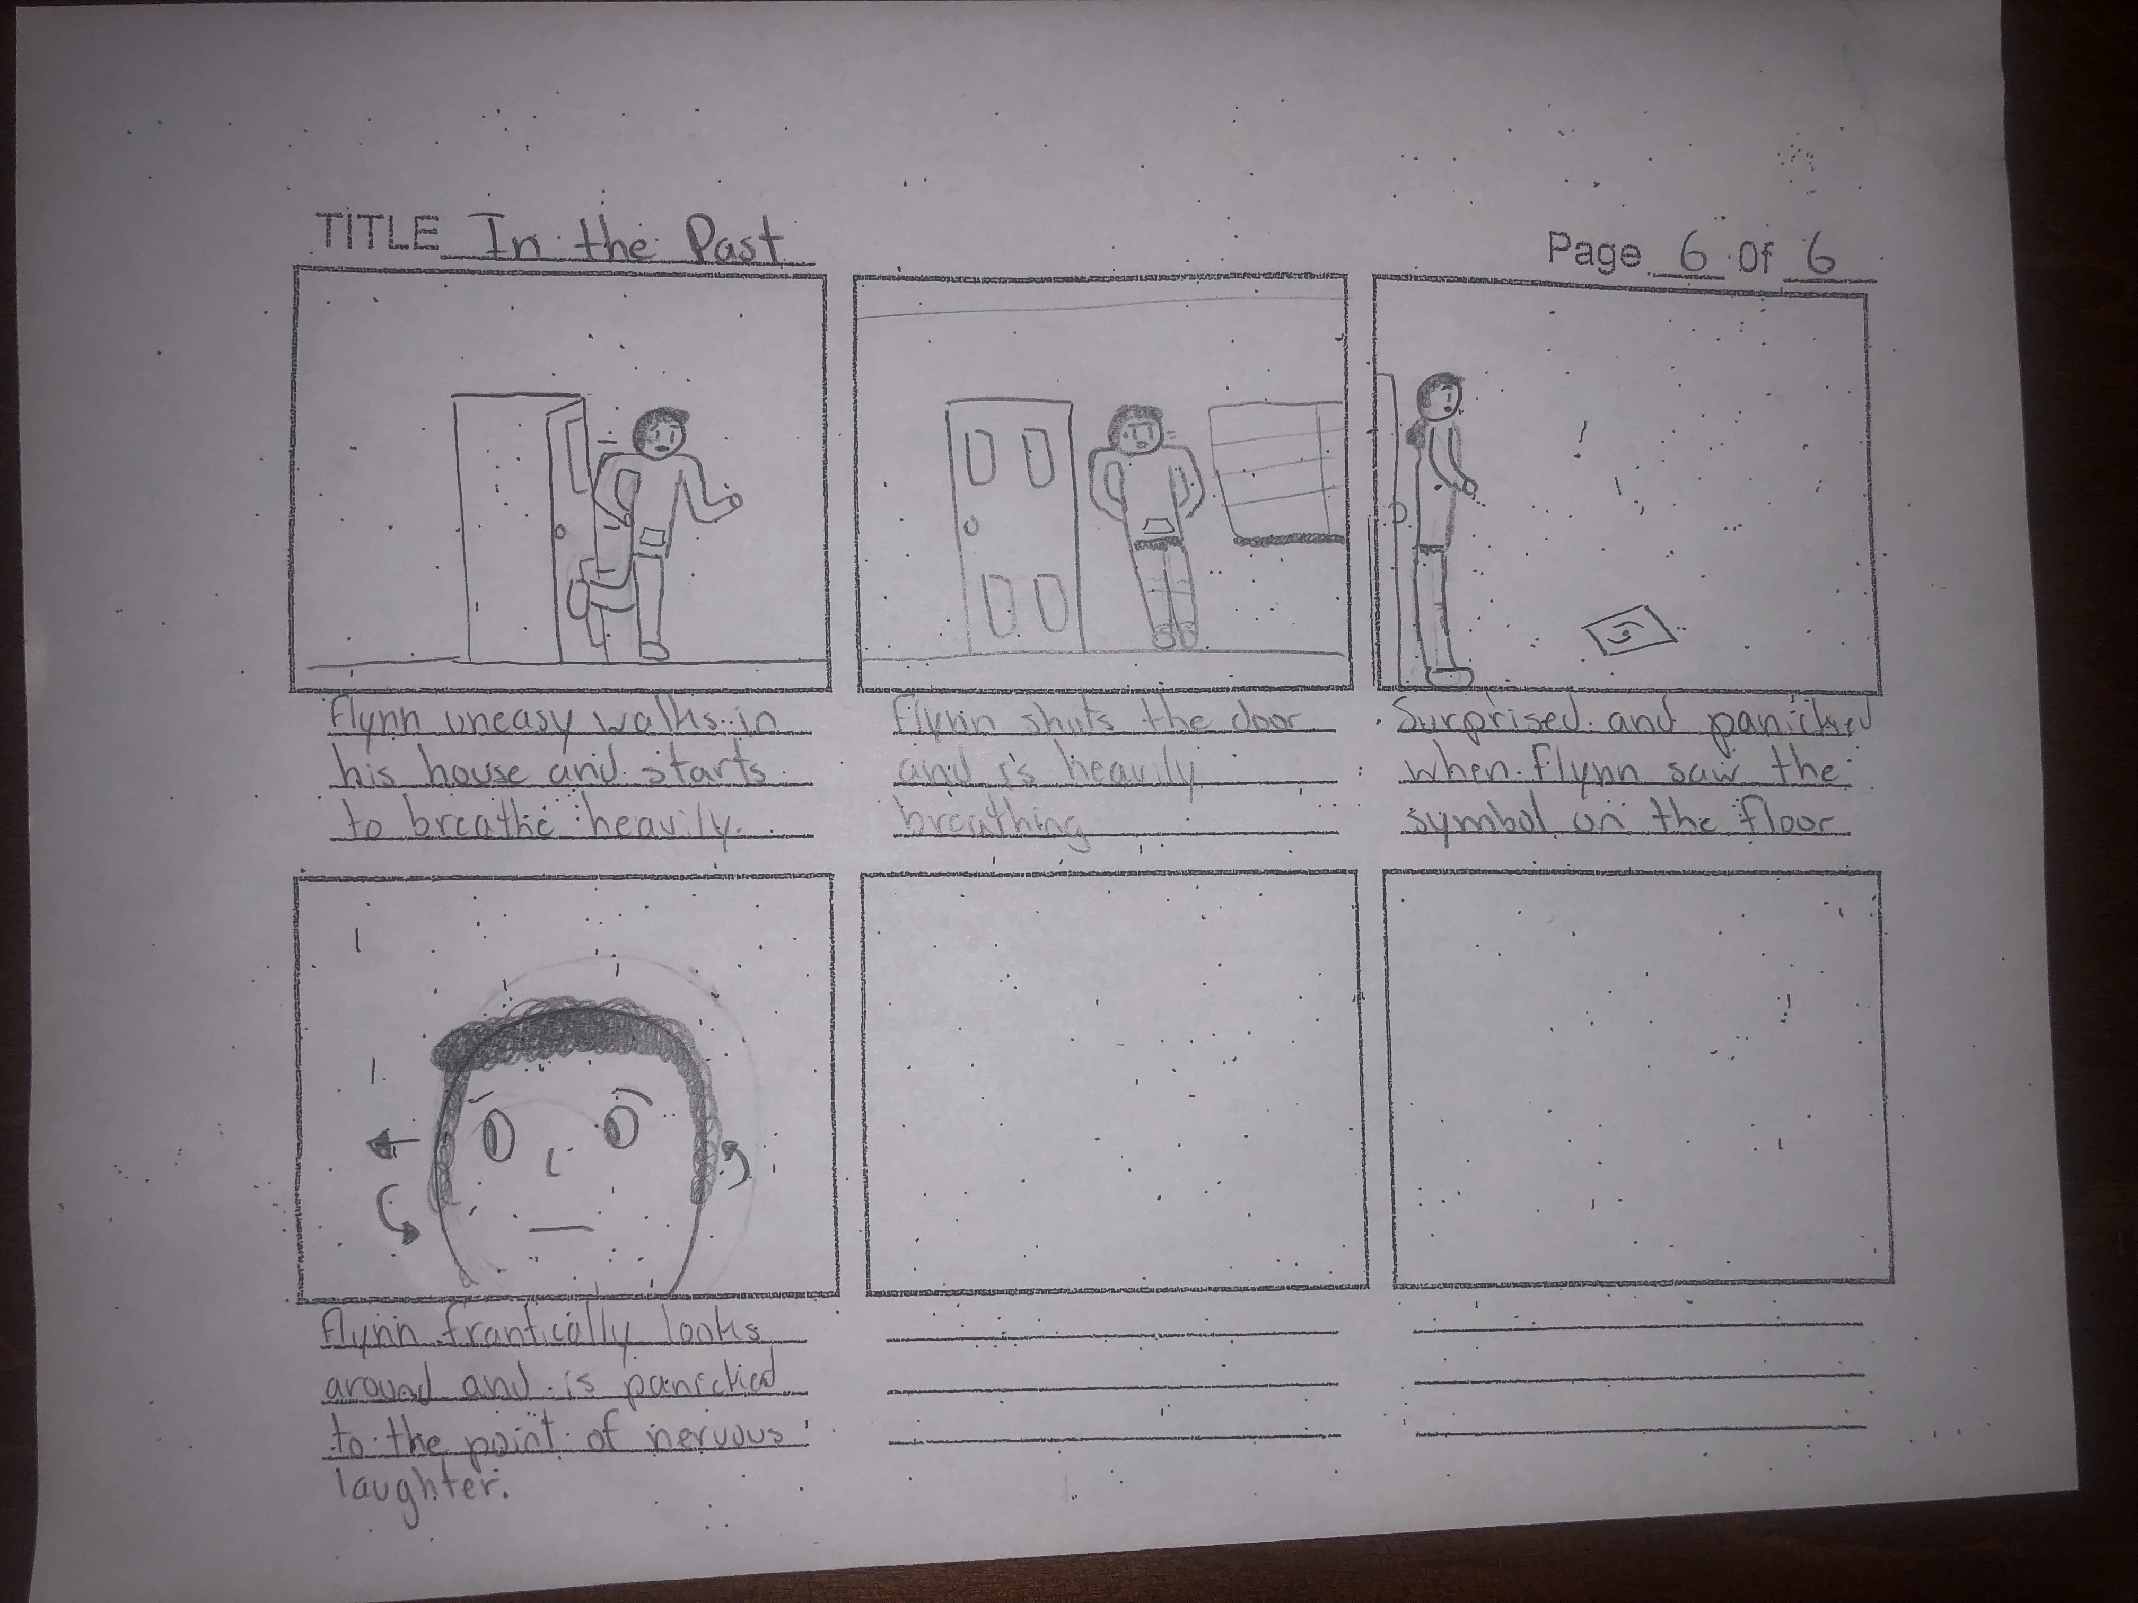
Page 6

